Slide 1


Katz and mySAP Retail
Partnership for
RETAIL SUCCESS
Janet Wright – Account Executive
Jim McMurray – Sr. Vice President, Retail Business Unit
Suzanne Montgomery – Retail Solutions Engineer

Slide 2
Agenda
  Retail Direction and SAP Viability
  SAP’s Commitment to Katz Group Canada Ltd.
  SAP’s Additional Benefits SAP Retail Customers
  SAP’s Solution
  Open Forum

Slide 3
SAP’s Retail Direction
  Increase our #1 Global market share in Retail
  Attain the #1 position in the North American retail market
  Develop executive level relationships with 3-5 retail market leaders in the North America
  SAP is aggressively investing in retail development
  Katz is a Strategic Account for SAP
  SAP Retail Business Unit Reports Directly to the SAP Board of Directors

Slide 4
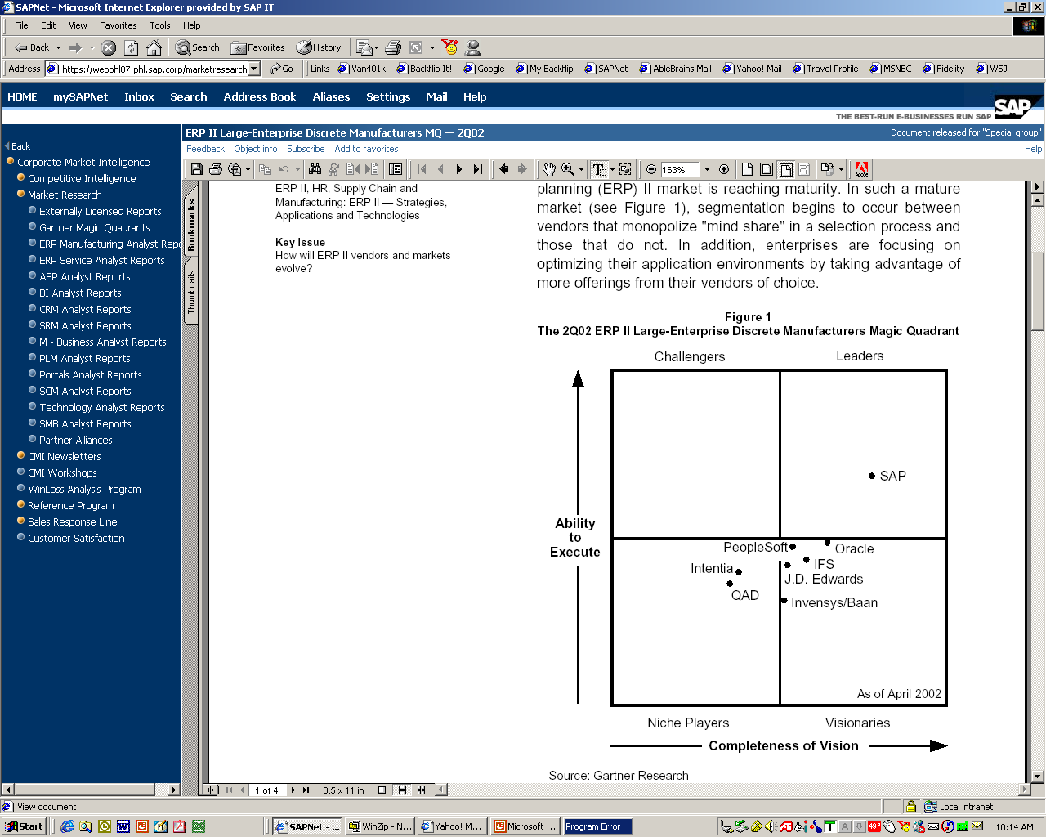
Market Leadership
Gartner
IDC
Gartner
Gartner
Gartner
Gartner
Gartner
IDC
Gartner
Gartner
#1 ERP
Enterprise Resource Planning
#2 CRM
Customer Relationship Management
#1 Financial
GL, AR, AP, FA, Controlling
#1 Human Resources
#2 PLM
Product Lifecycle Management
#1 SRM
Supplier Relationship Management
#1 SCM
Supply Chain Management
#2 Mobile Business
#2 Enterprise Portals
#3 Business Intelligence
January 2003, Gartner
Notes:
Key Points:
SAP is best of breed in may areas
Now you can have a real time integrated system and best of breed
SAP is not only viable but dominate as we pull away from the competition (offer greater ROI and less risk)
Transition: Now Ted will discuss SAP relevance for IBC

Slide 5

According to Gartner, 50 percent of today's software companies will vanish in two years . . .
"Not only will the small and weak
disappear, but major players will merge or be acquired to cause even well-known and substantial brands to vanish."
– Carl Claunch
Gartner Analyst
Gartner Symposium/IT Expo 2002

Slide 6
How Will We Get There
# 1

Slide 7

Summary of SAP Today
SAP in 2002 revenues: $7.4 billion
  60,100 installations
  19,300 companies run SAP
  28,797 SAP employees (December 2002)
12 million users in 120+ countries team with us to:
  Integrate their business processes
  Extend their competitive capabilities
  Get a better return on information at a lower total cost of ownership
Focused on users in all enterprises regardless of size
  Increased customer satisfaction and stronger customer loyalty
  Heavy R&D investment into SAP’s Products – Appox. $1B Annually

Slide 8
Is Your Business Standing Still?
Competition
Last 4 Qtr’s R&D spend $42M
Less: Amount funded by 3rd parties ($14M)
Net Retek R&D spend $28M
Change from previous 4 Qtr’s - 41%
2002 customer upgrades <5
Source: Soundview Q2 03 research report
SAP
Over 100 retail customers upgraded their solution in 2002
2003 YTD over 30 retail customers have upgraded
Spends a significant portion of maintenance on source segments
  A strong convenience base will drive additional R&D spending
R&D spending has increased each year over the same period

Slide 9
Summary of SAP Retail
SAP Retail
  1994 SAP Acquired Successful Retail Software Company
  Continuous Revenue & Profitability Increases
  1433 Retail Customers
  312 SAP Retail Merchandising Customers
  Over 100 SAP Retail Customer Upgrades in 2002
  Substantial Increase in 2003 Retail Investment
  Additional Board Funding for Retail in 2003
  3100 Development and Support Resources
    Solution Management
    Development
    Field Operations Support
    SAP Retail Leverages 2800 Development Resources
  Partner Network Capacity – Allowing Katz a Choice of Best Consultants
  Customers Like our Financial Viability with a Market Capitalization of over $35B
  Dedicated North American SAP Retail User Group – Retail ASUG

Slide 10
SAP 1990 – 2002
Millions $
Employees
8,000
28,797
30,000
28.410
Revenue
Employees
7,000
24.178
7,413
Profit
25,000
7.341
6,000
20.975
19.308
20,000
5,000
6.266
4,000
5.110
15,000
12.856
4.316
3,000
9.202
6.857
3.022
10,000
2,000
5.229
1,626
3.648
1.312
2.685
3.157
1.903
5,000
2.138
1.379
775
901
796
803
1,000
425
563
936
255
362
333
482
53
88
76
116
230
0
0
1990
1991
1992
1993
1994
1995
1996
1997
1998
1999
2000
2001
2002

Slide 11
SAP in Retail
SAP’s Commitment
Supporting Katz Business Requirements
Today and in the Future

Slide 12
Retail Development Commitment
In 2003, the retail development team will continue making significant investments in the SAP retail solution suite.
Advanced Forecast & Replenishment (14,000 person days)
  Highly sophisticated in stock, order quantity and stock optimization
Planning and SCM solution 25,000 person days
  Advanced planning and optimized supply chain solutions
POS Data Management 4,000 person days
  Advanced POS, sales audit and loss prevention for high volume operations
  2nd generation business intelligence for retail operations and senior management
Web based Staffworks 8,000 person days
  Labor efficiency and productivity for in-store associates
Other general product enhancements over 10,000 person days
  Retail Store enhancements, hand held support, usability enhancements

Slide 13
SAP Retail Commitment to Katz
  SAP to establish strategic relationship with Katz to extend upon our lead in delivering best in class solutions to drug store retailers
    SAP has commitment for this project directly from the Board: Convenience is a focus market for SAP Retail
    SAP will assign an Executive Sponsor from the retail business unit to Katz
    SAP will help to identify the best implementation
    team and appropriate change management process for Katz from SAP and our pool of partners
    SAP to invest in the Katz project to mitigate risk and insure Katz success
    SAP to provide Newtown Square facility for “E to E” on quarterly basis

Slide 14
SAP Examples
SAP Strategic Development Relationships
  Metro Germany – RFID
  KQ
  Tractor Supply
  Carrefour
  Coca Cola
  Philip Morris
  General Mills
  Nestle
  ConAgra
  Bayer
  Colgate Palmolive

Slide 15
SAP in Retail
SAP Retail Additional Benefits

Slide 16
SAP Additional Benefits
Most Comprehensive Product Offering:
  Human Resources
  Payroll*
  Employee Self Service
  Manager Self Service
  Facilities Management
  Project Systems
  Financials
  Asset Management
  Real Estate *
  Warehouse Management Systems
  Customer Relationship Management
  Supplier Relationship Management
  *requires additional licensing

Slide 17
SAP Additional Benefits
Most Comprehensive Product Offering:
  Manufacturing – Pharmaceutical / CPG / Food Process
  Lowest TCO
  24 x 7 Support
  Widest Selection of Consulting Resources
Dedicated Solution Manager for Drug/Grocery/Convenience Retailing

Slide 18
Supported by SAP and Its Partners
SAP CSN reinforces cooperation between SAP and its partners to support the entire lifecycle of solutions – from business concept to on-going solution performance improvement
Customer
SAP CUSTOMER SERVICES NETWORK
Consulting
Custom
Development
Education
Hosting
Support
PARTNERS
Notes:
SAP CSN reinforces cooperation between SAP and its partners to support the entire lifecycle of solutions – from business concept to on-going solution performance improvement
By providing everything from:
Consulting
Custom Dev. work
Educational services
Hosting
And support services

Slide 19
SAP – The Right Choice for Retail
  Designed for Your Industry
  Scaled to Your Business
  Ready for Your Future
  Committed to Katz’s Success

Slide 20
SAP in Retail
SAP Retail Customers

Slide 21
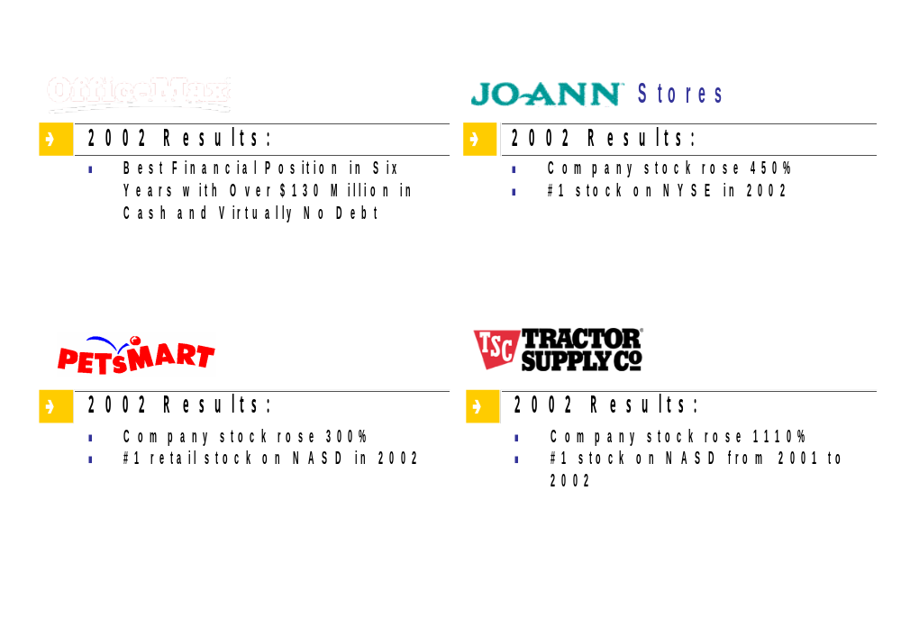
SAP: The Best Kept Secret in Retail

Slide 22

Customer Success – Tractor Supply Company
“Investments in inventory management systems and logistics infrastructure form a solid foundation. . .to focus on driving sales. “
Joe Scarlett
Chairman and Chief Executive Officer
ROI Realized:
Net Sales increased 19.3%
Same Store Sales increased 13.4%
Gross Margin improved 90 basis points over LY

Slide 23
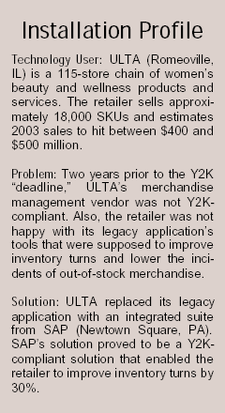
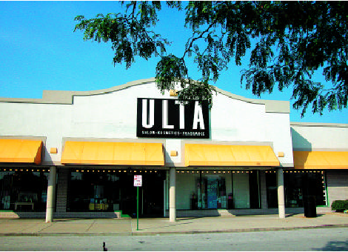
Customer Success - ULTA
After replacing its legacy merchandise management application with a merchandise management suite, beauty and wellness retailer ULTA realized a 30% improvement in inventory turns.
“Even though SAP had a stronger foundation in the ERP [enterprise resource planning] world, and at the time was just starting to be competitive in the retail industry, we saw a stable company with a tightly integrated product,”
      Greg Smolarek, ULTA
After making the decision to replace its legacy merchandise management solution, ULTA was able to roll out a new solution in nine months. Once the implementation was complete, ULTA’s in-store stock percentage rose from 96% to 98%.
Source: THE ANNUAL RESOURCE GUIDE TO RETAIL SOLUTIONS

Slide 24



SAP Retail
ONE PLATFORM BOOKMARKED FOR ALL
“In the evaluation process, we looked at four criteria: category management, inventory management, execution and customer support. We also checked customer references and looked under the covers to gauge exposed interfaces, upgrade capabilities, vendor stability and training available.
In the end, SAP came out on top”
Doug Caldwell, CTO, Indigo Books
"

Slide 25




Event Manager Customer Success
Colgate
  Implementing Event Manager to monitor events triggered within their RFID FutureStore architecture
  Tracks every parcel at every step from shipper to final delivery
  Provides web tracking to the shipper and the recipient
  Monitors transportation tendering process
  Tracks carrier response time and determines alternate carriers when needed
  Tracks and monitors delivery shipments and alerts customers of changes or pending arrivals
Notes:
Our Event Management solution is creating some highly satisfied customers.
Metro AG is implementing Event Manager to route RFID exceptions to the appropriate party
For example, Colgate monitors the transportation tendering process with its carriers. In addition they monitor delivery shipments and alert customers of changes or pending arrivals.
Canada Post has their SAP Event Management solution completely connected to third-party systems and tracks parcels as they move from the shipper to their final delivery points.
OfficeMax is planning to use Event Manager to monitor imports of promotional merchandise. Mikasa has expressed interest in Event Manager to track their import processes. Disney rated Event Manager highly in their evaluation of SAP’s solutions.

Slide 26
































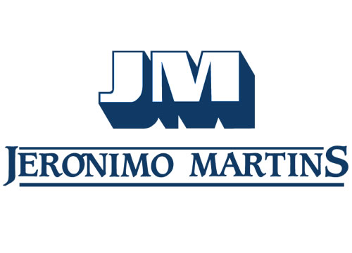

mySAP Retail – Grocery / General Merchandise
General Merchandiser
DIY/ Home Improvement
Misc. Speciality
Grocery

Slide 27







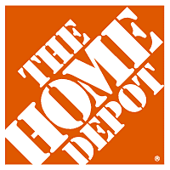












SAP Retail Data Warehouse Customer
4714 SAP BW customer installations worldwide
319 Retail customers worldwide
106 Live merchandise management reporting

Slide 28

SAP Retail Merchandise Planning Customers
OfficeMax (US)
Boutiques Jacob (Canada)
Reno (Germany)
Hemtex (Sweden)
Lojas Riachuelo (Brazil)
Lojas Americanas (Brazil)
Indigo Books (Canada)
Spengler (Switzerland)
Supervalue Inc. (Phillipines)
Harrods (UK)
COOP (Switzerland)
Migros (Switzerland)
Servicios Liverpool (Mexico)
Kesko (Finland)
Notes:
The retailers marked with a star are not typical fashion retailers and are using our merchandise planning capabilities.

Slide 29

Operative Category Management Customer Examples
Notes:
Customers using layout workbench with shelf optimization
Listing via shelf optimization

Slide 30
SAP StaffWorks - Customers
Specialty Retail
Services
American Eagle Outfitters
Footlocker
Ross
Coca Cola
Freedom Furniture (Aus)
GAP Inc.
Guess
Hastings Entertainment Inc.
J.Crew
Modell’s Sporting Goods
NBA Stores
Nike (US, Canada & Aus)
Petco
Rebel Sports (Aus)
Reebok International
Rite Aid Drugs
Staples
The Children’s Place
Talbot's Inc.
Virgin Megastores
Friendly’s
General Cinema / AMC
Jamba Juice
Starbucks (US & Aus)
McDonalds
Department Store
Boscov’s
Carson Pirie Scott - SAKS Inc.
David Jones (Aus)
Elder-Beerman
Gottschalks Inc
Hudson’s Bay Co. (Canada)
Myer Grace Brothers (Aus)
Big Box
Best Buy
BJ’s Whole Sale
Garden Ridge
Circuit City
Genuardi’s
IKEA
Lowe’s
Ukrop’s

Slide 31
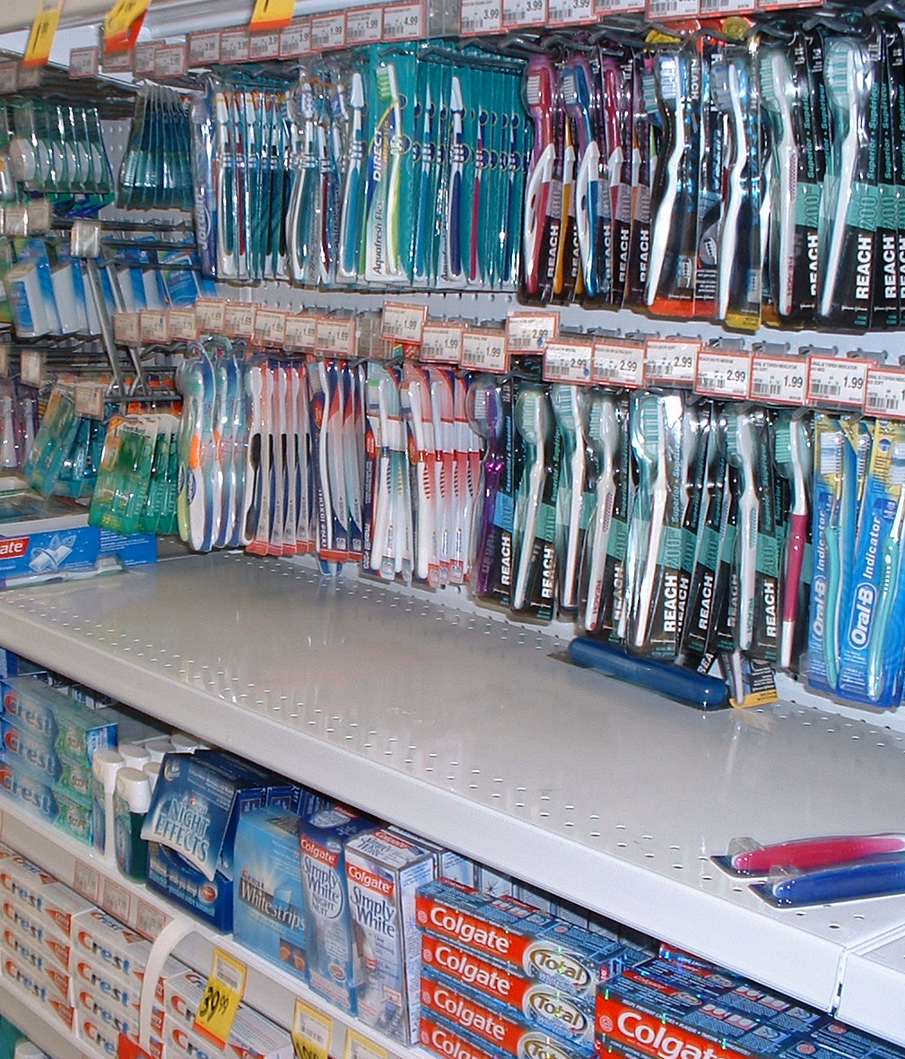
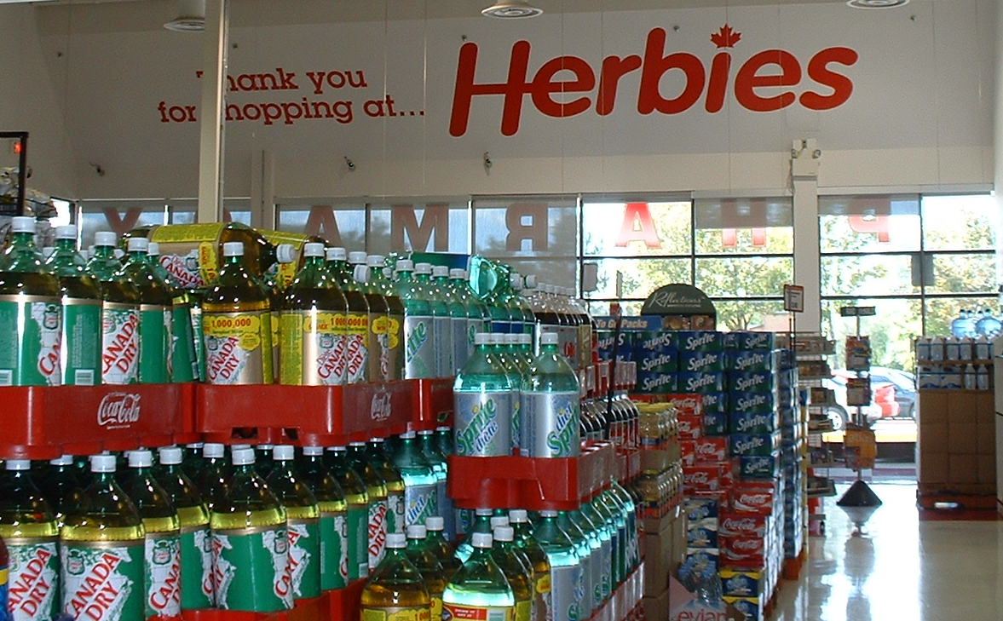
Suzanne Montgomery - Retail Solutions Engineer

Slide 32
SAP Retail Solution Components
Advanced Forecasting & Replenishment
Sophisticated forecasting algorithms
Auto replenishment
Advanced inventory optimization
Advanced supply chain analytics
Staffworks
Workforce Management
Merchandise & Assortment Planning
Merchandise Planning
Assortment Planning
Location Planning
Long-range Forecasting
Financial planning
WFM
Merchandise Management
Master data management
Assortment management
Purchase order management
Allocations
Pricing & promotions
Forecasting and replenishment
Load build / investment buy
Supply chain execution
Store management
Inventory management
POS in and outbound
Financials (AP, GL, AR, Real Estate)
Human resources/Payroll/ESS
SEM
Retail Supply Chain
Supply chain event management
Supply network planning
Transportation optimization
Customer Analytics
Customer reporting
Data mining
Advertising effectiveness
Campaign management
Loyalty management
Multi channel support
SCM
R/3 Enterprise
CRM
Data Warehouse
Retail reporting templates Data warehousing Information integration
BW
SAP Technology Stack

Slide 33
mySAP Retail Merchandise Management
Merchandise Management
Grocery / General Merchandise
Fashion Capabilities
R/3 Enterprise
Promotions
Store clustering / Assortment definition
Master Data Management
Market Basket Analysis
Competitive Pricing
Assortment Management
Manage styles/colors/sizes and prepacks
P.O. Management
Store – Forecast / Replenishment
Pull / CAO
Pre-allocation and PO linkage
Pricing and Promotions
DC – Forecast / Replenishment
Forecasting & Replenishment
Manage import shipments, documents, and pricing
Warehouse Management
Load Build / Forward Buy
Supply Chain Execution
Cross-docking / Flow-through
WM / LES
Inventory Management
In-season inventory visibility and management
Vendor Scorecard
Store Management
POS In and Outbound
Rebates / Allowances
Markdown pricing
Perishables / Dating
Financials (AP,GL,AR and Real Estate) / Human Resources, Payroll and ESS

Slide 34
SAP’s Category Management Solution
Category Management consists of complementary modules
that may be deployed independently of one another
Category Management Extranet
  Collaborative portal
  Data Warehousing & Analytics
  Data integration
CM
Analytics
Portal
CM Planning
& Master Data Planning
Category Planning
Operative Category Management
Sophistication
  Merchandise Management functionality
  POS data handling
Master Data
Management
Operative CM
& Supply Chain
POS
Data Management

Slide 35
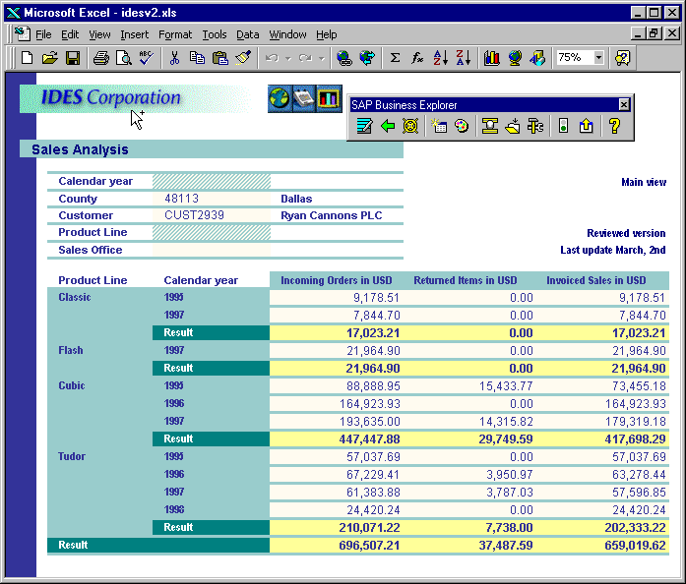

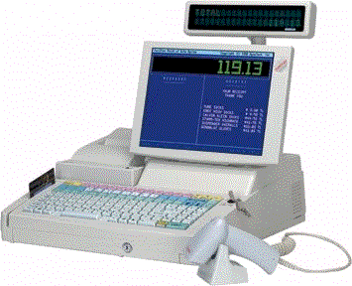
Solution approach – POS Data Management
Sales Analysis of POS Data
Store
Contr.
Loss Prevent
Promo
Analysis
BW-Reporting
Templates
SAP BW
mySAP
Solutions
PIPE
POS Inbound Processing Engine
Outbound Interfaces
3rd Party
Landscape
Upload of POS Data to SAP BW
via POS Inbound Processing Engine

Slide 36
SAP Delivers an Integrated Planning System
Strategic
Plan
Merchandise
Plan
Markdown
Allocation
Assortment Plan
Strategic
Plan
Purchasing
/OTB
Markdown
Promotion*
Purchasing/OTB
Allocation
Merchandise
Assortment
Forecasting
Space
Management
Space
SAP Retail Merchandise and Assortment Planning
Notes:
Note: In the first step Promotion is not an integrated part of the Merchandise & Assortment Planning Solution (based on SEM). Currently promotion is part of R/3 Enterprise. The integration of promotion is a vision.

Slide 37


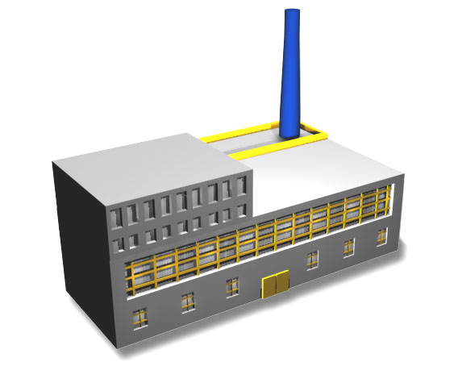
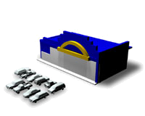
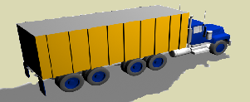
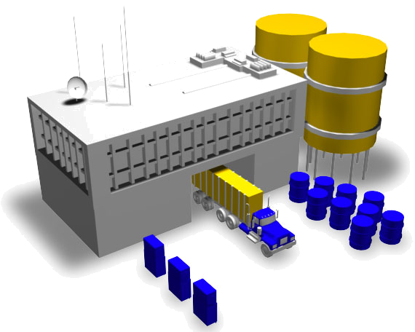
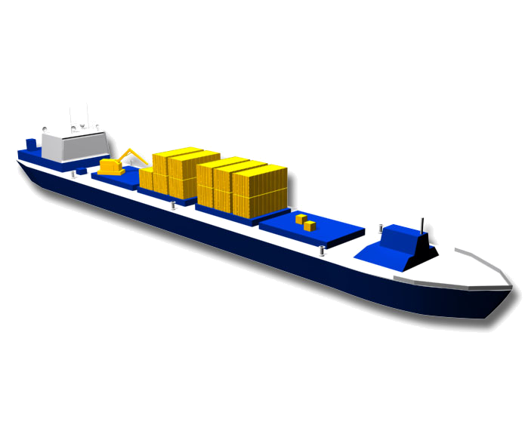
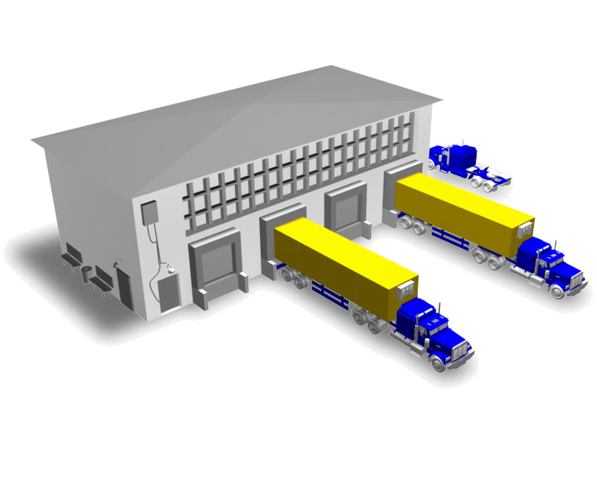
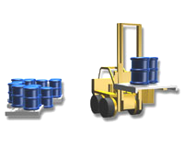
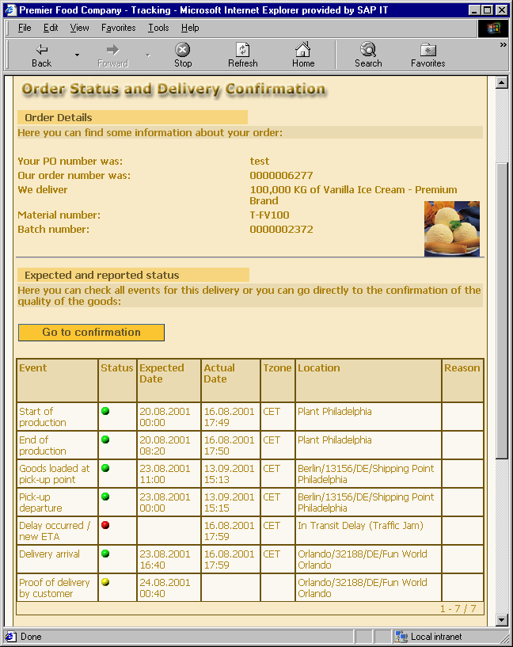
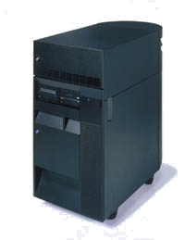
SCEM Example: Retail Import Process
Internet
PO acknowledgement
EDI
Purchase order
Vendor
RF Device
Goods receipt
Cross dock / issue
Retail Store
Vendor Factory
Retail DC
RF Device
Goods receipt
Internet
Production started
Production ended
ASN / goods issue
Consolidator
Carrier
EDI / Mobile Device
Shipment tender acceptance
Loading / unloading
Departure / arrival
Delay / ETA
Retail Event Manager System
Notes:
Lets walk through a real-life import example of how SCEM can be used to manage an entire business process.
We want to monitor the procurement process of sweaters from Asia to a DC in the US that will be cross-docked to stores.
The purchase order is delivered to the client electronically EDI, XML, Web forms, Etc.) and that event is registered in the Event manager.
Each party that touches the order updates event manager about their key portion of the fulfillment process.
Any stakeholder from purchasing, logistics and even the store mangers can see the status of any order via a web tracking interface.

Slide 38
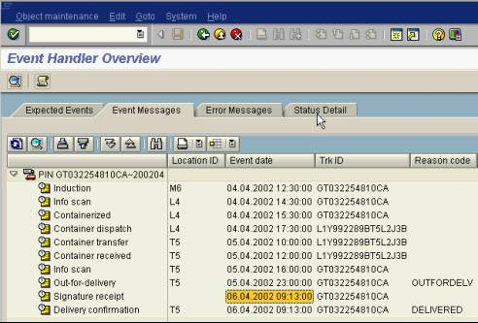
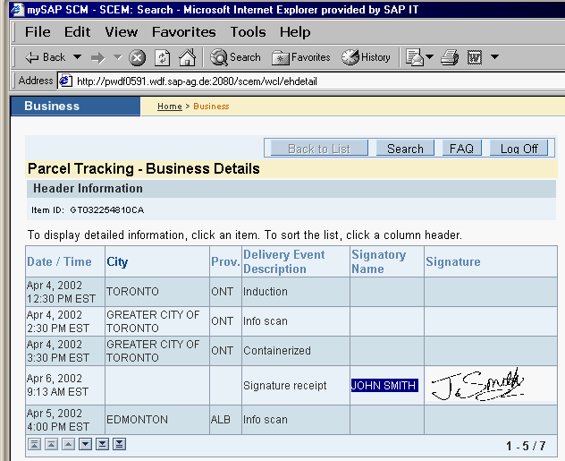
SCEM Example: Outbound Logistics Process (3/3)
The company provides real-time track and trace details to their customers through an integrated web page

Slide 39

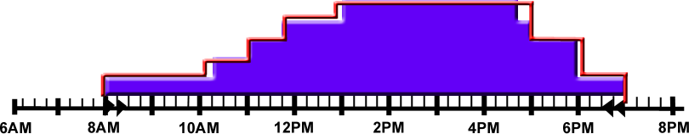
SAP’s Workforce Management - StaffWorks
Defined Work
Volume Data
POS & Traffic Data
Fixed Activities
Variable Activities
Flowed Activities
Determine the number of people needed for each 15 minute period
Labor Standards
Corporate Budget
Defined Constraints
Maximums / Minimums
Notes:
The next function required for creating a schedule is defining the demand forecast or the number of people required for each 15 minute period. To determine the demand StaffWorks looks at a variety of defined activities:
Fixed Activities which equates to defined work – example would be sweeping the floor, cleaning activities – activities that have defined time requirements and do not vary on traffic patterns.
Variable Activities which are volume driven - such as shipments, replenishment, markdowns – activities that may be impacted by a volume but not traffic patterns.
Flowed Activities which are POS or traffic driven – transactions, customer service, sales – these activities are impacted by both the volume and the traffic patterns.
Once these activities have been defined and captured a labor standard is applied along with defined constraints (number of registers, operating hours, maximum number of associates) and a corporate budget is applied and a demand forecast is created for each 15 minute period.

Slide 40

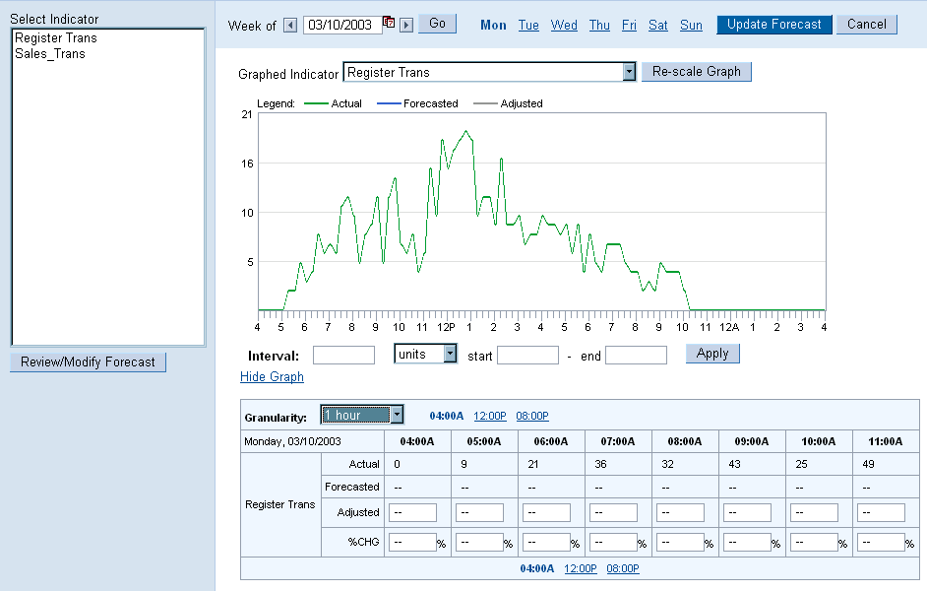
Forecasts
Forecasts
Employees
Schedules
Reports
Settings
Modify Forecasts – After a system Forecast is returned the Store Manager can modify the system forecast as needed before calculating a schedule

Slide 41
Approach: Segmentation of the Retail Industry
Segmentation of the Retail Industry by
Lines of Common Business Processes (LOC)
LOC 1
Fashion
e.g. textiles, fashion, shoes
Best Practices
for
mySAP Retail
Preconfigured Systems
LOC 2
Hard Goods
Standardization of Retail Enterprises according to
LOC
e.g. do-it-yourself, electrical,
toys, sport equipment
LOC 3
Food
e.g. supermarket, discount store,
convenience store, hypermarket,
cash&carry
LOC 4
Wholesale
e.g. supplying wholesale,
Internet, mail-order

Slide 42

Q&A

